Slide 1
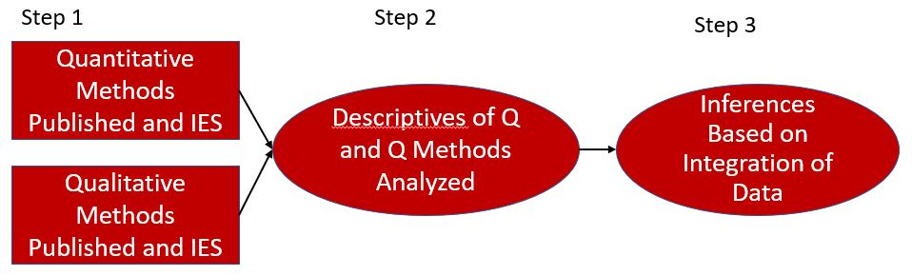
An Integrated Analysis of the Quantitative and Qualitative Methods Used in Mixed Methods K – 12 Educational Research and in Institute of Education Sciences Funded Research From 2014 – 2019
Karen M. Alexander and Jay Jeffries
Buros Center for Testing and University of Nebraska-Lincoln Department of Educational Psychology
Study Purpose
The purpose of this study is to explore potential differentials in the robustness of quantitative and qualitative research methods between published MM educational research and IES funded research. To analyze this, the following research questions were used: What quantitative methods have been used in MM K – 12 educational research and in IES funded studies from 2014 – 2019? What qualitative methods have been used in MM K – 12 educational research and in IES funded studies from 2014 – 2019? What relationships between the quantitative and qualitative research methods used in K – 12 educational research and IES funded studies are found by integrating the systematic review?
Method
A convergent parallel mixed methods analysis was used to conduct a mixed methods systematic review (MM-SR) of the quantitative and qualitative methods used within MM educational research and IES funded research for K-12 education from 2014-2019 allowing for an integrated comparison of the rigor of quantitative and qualitative methods.
IES Study
Journal Article
Results
Disparities between MM educational research funded by IES and not funded by IES exist in terms of reporting qualitative analysis methods. Among the journal articles in the sample of studies, 91.41% (N = 234 articles) reported a process of qualitative coding or analysis whereas the research funded by IES only 13.22% (N = 39 documents) disclosed a type of qualitative analysis. This represents a significant difference (χ²(1)= 335.17, p < .05). Non-IES funded research identified a qualitative data analysis method significantly more than IES funded studies. This is shown in journal articles that used deductive-leaning methods in complexity level 1 significantly more (χ²(1)= 56.69, p < .05), medial analyses of level 2 (χ²(1)= 123.11, p < .05), and inductive-leaning methods in complexity level 3 (χ²(1)= 212.89, p < .05). No difference exists between MM educational journal articles and IES funded studies reporting of quantitative methods. The studies funded by IES utilized multivariate analyses (χ²(1)= 6.47, p < .05), analyses of time and/or space (χ²(1)= 26.51, p < .05), multi-directional or multilevel models (χ²(1)= 231.81, p < .05), and multidirectional and multilevel modeling (χ²(1)= 27.53, p < .05) significantly more than non-IES funded journal articles. Journal articles implemented descriptive analyses (χ²(1)= 93.20, p < .05), univariate analyses (χ²(1)= 131.30, p < .05), and measurement techniques (χ²(1)= 4.93, p < .05) significantly more than IES funded studies. The proportion of documents that used complexity level 4 , analysis of group membership, was not significantly different among IES and non-IES funded research. While it has been a goal for IES to better guide researchers towards more sufficient MM quality, it is apparent that the research they support concentrates its efforts and resources into quantitative evidence. Because of this, the austerity of qualitative data analysis methods trails in expectation.
Discussion
We believe descriptive statistics and qualitative methods are underreported for IES funded research but is not of immediate concern. Underreporting of qualitative methods speaks to the lack of emphasis on the value of qualitative methods. IES needs to be just as explicit with qualitative methods as quantitative methods if rigor of methods is important. Findings will continue into comparisons of IES research purpose, research method, and mixed methods designs to identify other characteristics and distinctions.
References
Institute of Education Sciences (IES), U.S. Department of Education (USDE), & National Science Foundation (NSF). (2013). Common Guidelines for Education Research and Development. https://ies.ed.gov/pdf/CommonGuidelines.pdf Onwuegbuzie, A. J. (2016). A Call for Conducting Multivariate Mixed Analysis. Journal of Educational Issues, 2(2), 1-30. https://doi:10.5296/jei.v2i2.9316

